Slide 1
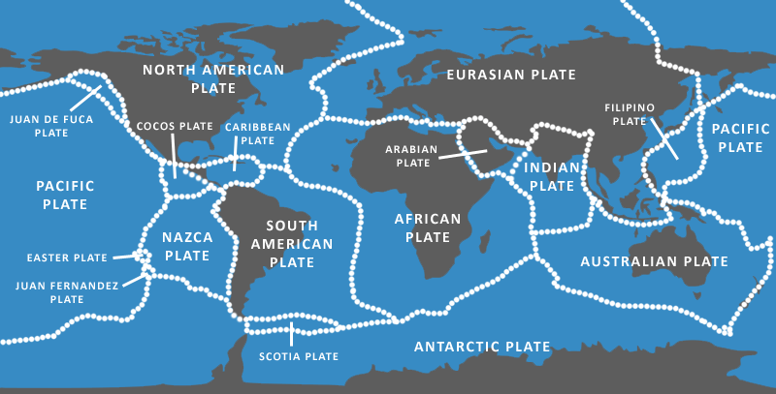
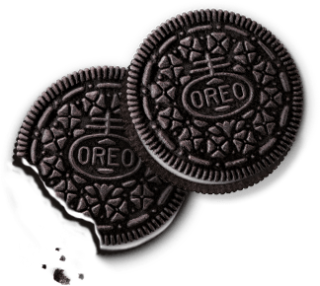
Oreo Tectonics
We can simulate how plates move on the Earth’s surface using Oreo cookies.

Slide 2
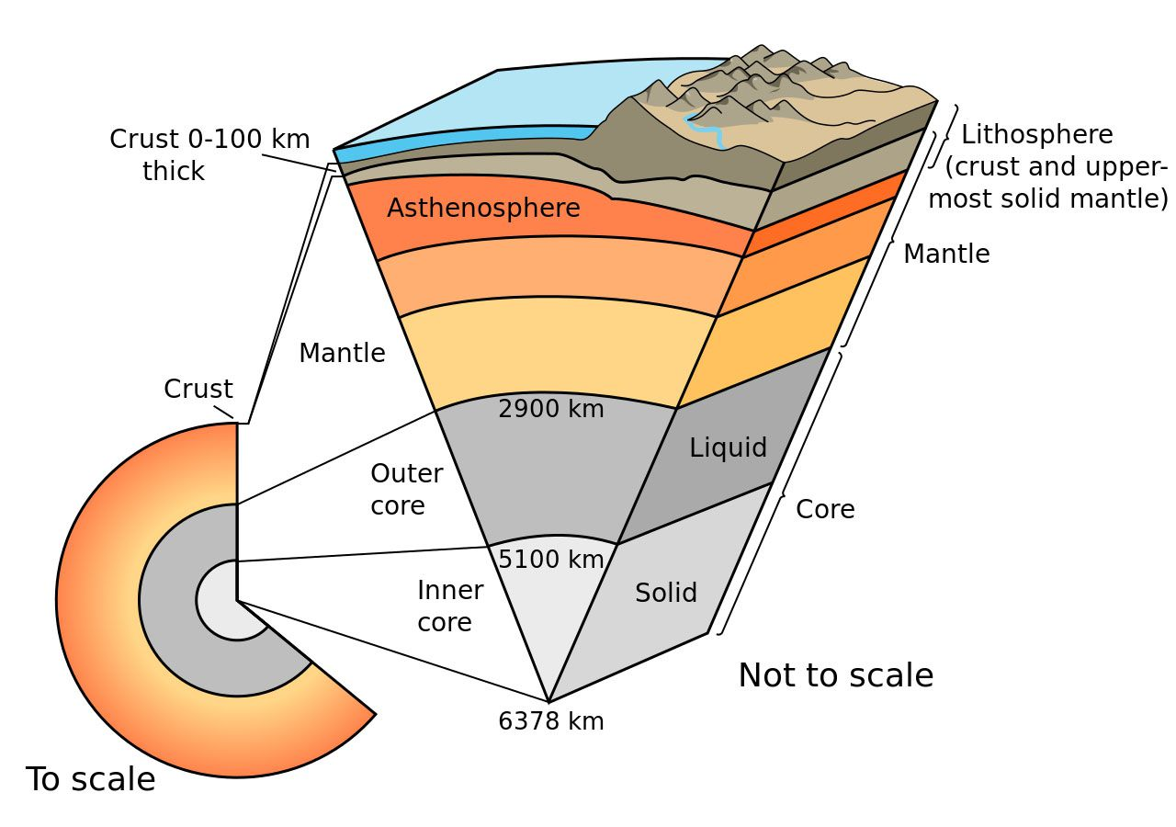
The term tectonics originates from the Greek word “Tekton,” referring to a builder or architect. Plate tectonics suggest that large features on Earth’s surface, such as continents, ocean basins and mountain ranges, result from interactions along the edges of large plates of the Earth’s outer shell.
This outer shell is called the lithosphere from the Greek “Lithos” meaning hard rock. The plates composed of the Earth’s crust and uppermost mantle, ride on a warmer, softer layer of the mantle, called the asthenosphere.

Slide 3
In our experiment:
Upper cookie = lithosphere
Creamy filling = asthenosphere
Lower cookie = lower mantle

Slide 4
Choose a cookie… don’t eat it yet!
First carefully remove the upper cookie (a twisting motion is required).
Slide the upper cookie over the creamy filling. This motion simulates the movement of the rigid lithosphere plate over the softer asthenosphere.
Next, break the upper cookie in half. As you do so listen to the sound it makes.
What sound do you hear?
What does this breaking represent?

Slide 5
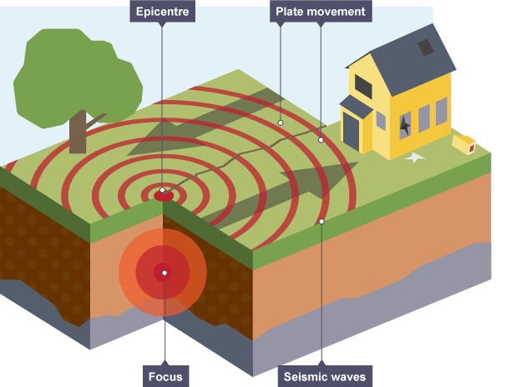
What sound do you hear?
What does this breaking represent?
An Earthquake!
It takes a cold brittle, lithosphere to make earthquakes – earthquakes do not occur in the soft, flowing asthenosphere.

Slide 6
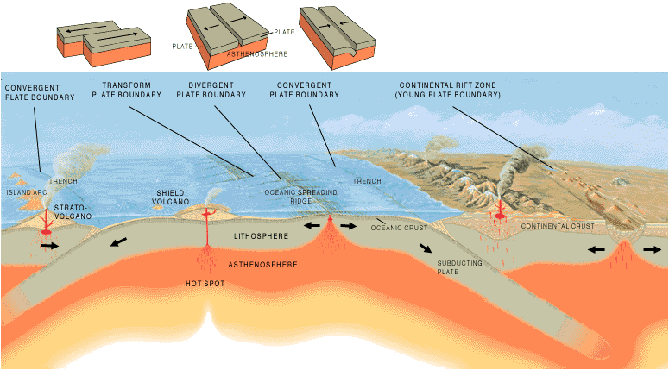
Plate
Plate
Mantle
To simulate a constructive plate boundary, push down on the two broken cookie halves and slide them apart. Notice that the creamy filling between the two broken “plates” may tend to flow upward, similar to the rising, decompression, and partial melting of hot asthenosphere at mid-ocean ridges and continental rift zones.

Slide 7
Plate
Plate
Push one cookie piece beneath the other to make a destructive plate boundary. Note that this is the only situation where the cold, brittle lithosphere extends to great depths, and hence the only place where deep earthquakes occur. The very largest earthquakes are at subduction zones where two plates get stuck together for centuries, then suddenly let go.

Slide 8
Simulate a conservative plate boundary by sliding the two cookie pieces laterally past one another, over the creamy filling. You can feel and hear that the “plates” do not slide smoothly past one another, but rather stick then let go, stick then let go. The cracking sound you hear each time is like an earthquake occurring along the San Andreas Fault in California.

